Slide 1


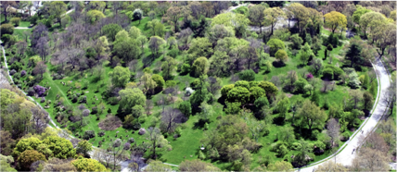
Arnold Arboretum Tree Spotters
New Volunteer Training May 24, 2016
Wolkovich Lab, Harvard University
Jehane Samaha, Project Manager
Suzanne Mrozak, Volunteer Coordinator
Danny Schissler, Intern
Cat Chamberlain, Graduate Student
Notes:
Introduce ourselves – just names and titles/roles
Suzanne Mrozak, Tree Spotter Volunteer Coordinator
Jehane Samaha – introduce herself
Danny Schissler – introduce himself
Cat Chamberlain – introduce herself
We will be giving you all an opportunity to introduce yourselves after the Overview section.
The training is scheduled to take 2 1/2 hours.
Breaks
We will have a 10-minute break after about an hour.
Point out
The restrooms
Water fountains
Exits
Fire extinguisher
Snacks, coffee/tea (help yourself any time)
Handouts (please return anything you don’t need so we can use them for the next class)
Reference materials to look at (please do NOT remove them from the room)
Information about the Arboretum on the back table. (If there is any.) Help yourself.

Slide 2
Tree Spotters Citizen Science Program
Agenda
Overview
Hands-on Tree Spotting (weather permitting)
The ABCs of Tree Spotting
Wrap Up
Notes:
I will start off with an overview of the Tree Spotters program and we will follow that with a little ice-breaker, so you all get to know each other a little better.
Then, weather permitting, we will take a little trip outside to visit one of our trees while there is still daylight.
When we get back, Jehane will take over to talk about what it means to go Tree Spotting: what you are being asked to observe, how to record what you see, and how to enter your observations into Nature’s Notebook.
Danny will finish by telling you about what happens next, some of the resources we have available, our plans for the rest of this year, and how to get help if you need it.

Slide 3
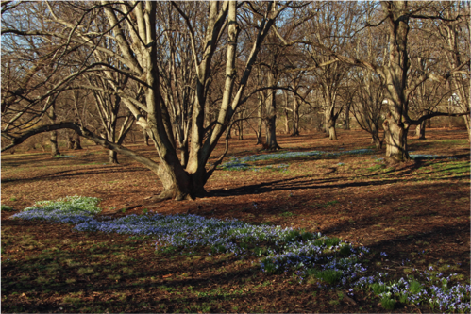
Tree Spotters Citizen Science Program
Overview
Photo: S. Mrozak
“A few minutes ago every tree was excited, bowing to the roaring storm, waving, swirling, tossing their branches in glorious enthusiasm like worship. But though to the outer ear these trees are now silent, their songs never cease.”
-- John Muir, naturalist, explorer, and writer (1838-1914)
Notes:
The lindens on April 22nd last year. This year, the flowers were already blooming at the end of March!
I plan to go out a take another photo at the same place this coming April 22nd ☺

Slide 4
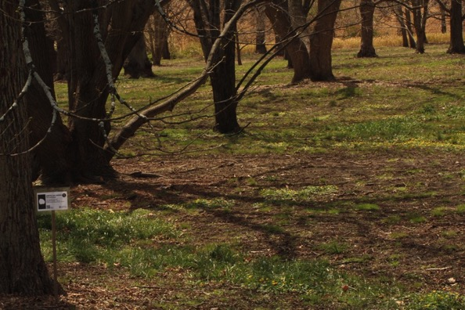
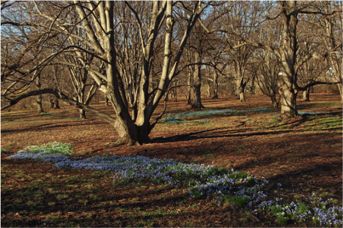
Tree Spotters Citizen Science Program
Overview
Photo: S. Mrozak
“A few minutes ago every tree was excited, bowing to the roaring storm, waving, swirling, tossing their branches in glorious enthusiasm like worship. But though to the outer ear these trees are now silent, their songs never cease.”
-- John Muir, naturalist, explorer, and writer (1838-1914)
Notes:
The lindens on April 22nd this year. The flowers were blooming by the end of March and long gone by April 22nd.
I plan to go out a take another photo at the same place next April 22nd ☺

Slide 5
Tree Spotters Citizen Science Program
Overview
What are we doing?
Why are we doing it?
What are we asking Tree Spotters to do?
Some of the benefits of being a Tree Spotter
The importance of observation and record keeping
Citizen Science

Slide 6
Tree Spotters Citizen Science Program
What are we doing?
Observing the life-cycle stages of eleven different species of trees at the Arnold Arboretum through the seasons and through the years.
Recording our observations.
Entering our observations into an online database managed by the National Phenology Network (NPN).
Notes:
What is Tree Spotting?
Life-cycle stages, for example: When leaves first appear, when flowers first appear, when fruit first appears, when fruit is ripe, when leaves start to turn color, when leaves start to fall…
The next slide lists the eleven species of trees we are following.
A total of 55 trees – 5 individuals per species -> volunteers can follow any trees they’d like at any stage

Slide 7
Tree Spotters Citizen Science Program
Our trees
Acer saccharum Sugar Maple
Aesculus flava Yellow Buckeye
Betula alleghaniensis Yellow Birch
Betula nigra River Birch
Carya glabra Pignut Hickory
Carya ovata Shagbark Hickory
Fagus grandifolia American Beech
Populus deltoides ssp. deltoides Eastern Cottonwood
Quercus rubra Northern Red Oak
Quercus alba White Oak
Tilia americana American Linden (aka Basswood)
Notes:
We are observing 5 different trees in each of these 11 species, for a total of 55 trees. These trees are in various locations on the Arboretum grounds.

Slide 8
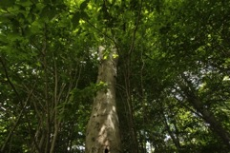
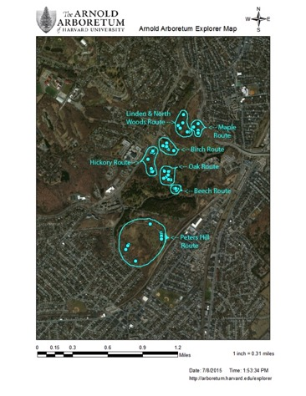
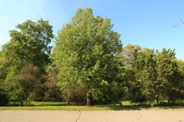
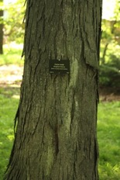
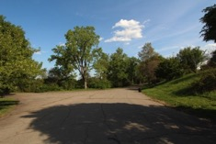
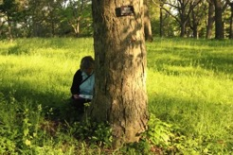
Tree Spotters Citizen Science Program
Our trees
Photos: S. Mrozak
Notes:
Since our trees are scattered around the Arboretum, we have designed 7 walking routes for you to choose from. Our seven routes–Beech Route, Birch Route, Hickory Route, Linden and North Woods Route, Maple Route, Oak Route, and Peters Hill Route–vary in terrain and number of trees to observe.
NOTE: You are NOT required to observe all of these trees. (We’ll talk more about that in a minute.)
Beech Route 5 trees. Closest Arboretum gate: South Street Gate. Moderate terrain, close to paved road. Estimated observation time: 30 minutes.
Birch Route 10 trees. Closest Arboretum gate: Centre Street Gate. Moderate terrain, mostly off-road. Estimated observation time: 55 minutes.
Hickory Route 10 trees. Closest Arboretum gate: Centre Street Gate. Moderate terrain, mostly off-road. Estimated observation time: 55 minutes.
Linden and North Woods Route 7 trees. Closest Arboretum gate: Arborway Gate. Mild terrain, mostly off-road. Estimated observation time: 40 minutes.
Maple Route
4 trees. Closest Arboretum gate: Arborway Gate. Mild terrain, on or close to Willow path. Estimated observation time: 30 minutes.
Oak Route 9 trees. Closest Arboretum gate: Centre Street or South Street Gate. Moderate terrain, mostly off-road, some wood-chip path. Estimated observation time: 50 minutes.
Peters Hill Route 9 trees. Closest Arboretum gate: Peters Hill Gate or Poplar Gate. Moderate terrain, mostly on-road, and there are five species here: Linden, Cottonwood, Sugar Maple, White Oak, and Yellow Buckeye. Longest walking distance and the least flat. Estimated observation time: 50 minutes
ARB EXPLORER: http://arboretum.harvard.edu/explorer/ - Featured Tours

Slide 9
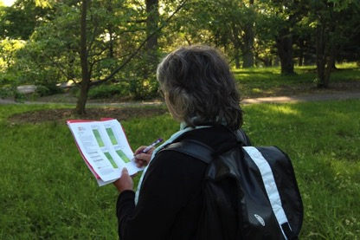
Tree Spotters Citizen Science Program
The life cycle stages we are observing
Breaking leaf buds
Leaves
Increasing leaf size
Colored leaves
Falling leaves
Flowers or flower buds
Open flowers
Fruits
Ripe fruits
Recent fruit or seed drop
Photo: S. Mrozak
Phenophases
Notes:
This brings us to the DEFINITION OF PHENOLOGY

Slide 10
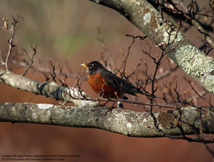
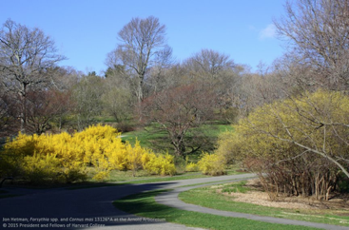
Tree Spotters Citizen Science Program
Phenology
Emergence
Blooms, buds, fruits
Migration, hibernation, dormancy
Easy to observe
The study of the timing of recurring plant and animal life-cycle stages, or phenophases, and their relationship to environmental conditions.
Notes:
When does the first robin arrive? When does the forsythia bloom? In this area, we see these events as signs that spring has arrived.
At the bottom is the “technical” definition of phenology, as defined by the USA National Phenology Network.
Note that while the term Phenology applies to animals as well as plants, we are only officially observing trees.
Ask for a show of hands – how many people had heard the term before the heard about this class?
Ask if the term was new to you, what you first thought of when you heard it.
After this, point out that sometimes when people hear the term for the first time, they think it’s something else –
phRenology – a pseudoscience focused on measurements of the human skull and size of the brain
phOnology – a branch of linguistics concerned with the organization of sounds in language
Point out that if you have heard the word “phenotype” (usually in comparison to “genotype”) the root is the same: it’s about appearance – like the appearance of a trees buds.

Slide 11
Tree Spotters Citizen Science Program
Why are we doing it?
Plant phenology is now the most reported biological indicator of anthropogenic climate change.
Related research is being conducted in Dr. Elizabeth (Lizzie) Wolkovich’s Temporal Ecology Lab at Weld Hill:
Ailene Ettinger – to what extent can phenology be used to predict shifts in tree growth
Sally Gee – how phenology stages relate to one another
Notes:
Have Jehane speak to this slide
We will talk more about how we are recording our observations and about the Nature’s Notebook application later.
Right now, let’s talk about why we are observing these particular trees:
We just talked about “Phenology” as the study the timing of recurring life events. Many researchers have documented shifts in leaf out and flowering times as temperatures have risen over the last several decades, and plant phenology is now the most reported biological indicator of anthropogenic climate change. This research has highlighted the tremendous variation in phenological responses across space, time, and species. For example, not only do tree species normally vary greatly in their phenology (magnolias bloom early in the spring whereas catalpas often bloom two months later, for example), but the extent to which climatic shifts affect phenology also varies widely. Understanding this variation is critical to accurate predictions of future climate change and estimates of shifts in major ecosystem services, such as pollination - and is central to current research being conducted in Dr. Elizabeth (Lizzie) Wolkovich’s Temporal Ecology Lab at Weld Hill, where there are two ongoing research projects at that will benefit from Tree Spotters data.
(NOTE: Humankind benefits in a multitude of ways from ecosystems. Collectively, these benefits are becoming known as ecosystem services. Ecosystem services are regularly involved in the provisioning of clean drinking water and the decomposition of wastes. While scientists and environmentalists have discussed ecosystem services implicitly for decades, the ecosystem services concept itself was popularized by the Millennium Ecosystem Assessment (MA) in the early 2000s.^{[1]} This grouped ecosystem services into four broad categories: provisioning, such as the production of food and water; regulating, such as the control of climate and disease; supporting, such as nutrient cycles and crop pollination; and cultural, such as spiritual and recreational benefits. To help inform decision-makers, many ecosystem services are being assigned economic values.)
Ailene Ettinger, a postdoctoral researcher, is investigating the extent to which phenology may be used to predict shifts in tree growth under climate change. In other words, are trees that leaf out earlier more sensitive to shifts in climate? Is their growth likely to increase or decline with forecasted rising temperatures over the next century?
Sally Gee, an undergraduate student, studies how phenology stages relate to one another (for example, do individuals that leaf out earlier also flower earlier?), as well as to other important plant characteristics, such as tree height and wood density. These relationships may be used to predict how species will respond to climate change. We know that phenology is shifting with climate change, and if we can correlate phenology with other tree characteristics, we will better understand additional biological responses to climate change.

Slide 12
Tree Spotters Citizen Science Program
What are we asking Tree Spotters to do?
Visit as many of our trees as possible as often as possible (at least twice/month).
Observe and record the phenophases for each tree you visit on a Nature’s Notebook datasheet.
Enter the datasheet information into your Nature’s Notebook Observation Deck.
Notes:
Be a regular observer – on your own, or with a partner or a group. (If you want company, let us know and we can meet you in the field.)
Be an attentive and conscientious observer.
Record your observations accurately.
Explain how it fits into the way people have been keeping journals and how we are now using that information. Just use the Marsham and Thoreau examples.

Slide 13
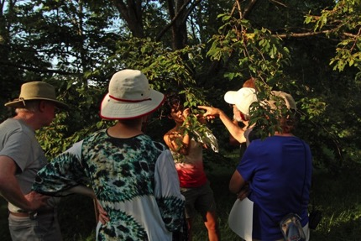
Tree Spotters Citizen Science Program
What are we asking Tree Spotters to do?
Give us your feedback.
Attend occasional educational sessions.
Photo: S. Mrozak
Notes:
For example, answer occasional surveys.
Educational sessions-Hunnewell Building lecture hall: we hope to present topics of interest. For example, we have three more Botany Blasts coming up:
March 26th, 9:30 AM – 10:30 AM: Clues to Climate Change with Richard Primack, Professor of Biology at BU and author of Walden Warming. Note: You can hear a recent conversation with Dr. Primack on the SciDev.Net site.
April 11th, 5:30 PM – 7:00 PM: Buds, Leaves, and Flowers: Springtime Phenology with Lizzie Wolkovich, Assistant Professor, Organismic and Evolutionary Biology, Harvard University and Jehane Samaha, Tree Spotter Project Manager and Laboratory Technician in Lizzie’s Lab. NOTE: This presentation will start at Hunnewell Building, then roam the Arboretum to discuss several Tree Spotter species.
April 28th: 6:00 – 7:00 PM Trees and Predator Interactions with Andrew Gapinski, Manager of Horticulture at the Arnold Arboretum.
We are assuming we will continue this series next winter/early spring.

Slide 14
Tree Spotters Citizen Science Program
Some of the benefits of being a Tree Spotter
Spending time outdoors, among the trees, is good for your health.
You have the satisfaction of knowing you are contributing to the greater good.
You have the opportunity to learn something new.
You have the opportunity to meet like-minded people.
Notes:
Benefits of being outdoors:
Trees mark the seasons
Trees add music to your life by attracting birds and other animals
Trees can provide pleasant smells
Trees provide us with color, flowers, fruit, interesting shapes and forms to look at
Trees link us to near and distant generations
Studies have documented that urban vegetation can result in slower heartbeats, lower blood pressure, and more relaxed brain wave patterns
In Japan, people practice “Forest Bathing, where the spend quiet time absorbing the wisdom of the ancient forests, taking long walks among the trees to stimulate their immune system.
The data you collect will advance our understanding of the effects of climate change
The massive collaborations that can occur through citizen science allow investigations at continental and global scales and across decades--leading to discovery that a single scientist could never achieve on their own.
The next slides are a bit of aside, but we wanted to highlight the importance of observation and record keeping and give you some tips on journaling in general.

Slide 15
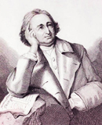
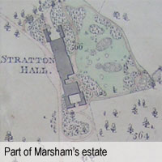
Tree Spotters Citizen Science Program
The importance of observation and recordkeeping
Robert Marsham Father of modern phenology
In 1736, he started systematically and precisely recording the signs of spring on his estate in Norfolk, England.
He called them “Indications of Spring”.
His family continued this tradition until 1958.
Notes:
Going back to what we are asking you to do
Be a regular observer
Be an attentive and conscientious observer.
Record your observations accurately.
Is part of a continuum. People have been keeping nature journals for centuries and scientists are now using that information as they study the effects of climate change.
Marsham and Thoreau examples.
The father of Modern Phenology is considered to be Englishman Robert Marsham, who was born in Stratton Strawless, between Norwich and Aylsham, in Norfolk, in 1708. In 1736, he started systematically and precisely recording the signs of spring on his estate in Norfolk. He called them his Indications of Spring. He continued to note down significant dates for the next 62 years recording some 27 natural events for more than 20 animals and plants. These included tree leafing times and the arrival of migrant birds. This made such an impact on his family that they carried on his work for until 1958 when Martha Marsham died. These records have been invaluable to scientists examining climate change.
Marsham's main reason for keeping these records was to improve the timber production on his estate. He was one of the first to carry out repeated experiments on root cutting, trenching and bark scrubbing.

Slide 16
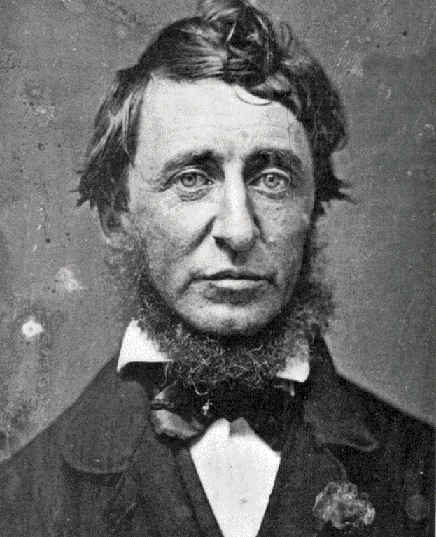
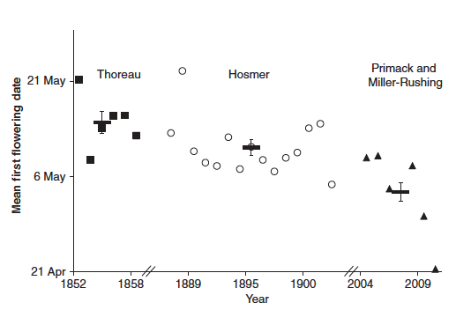
Tree Spotters Citizen Science Program
The importance of observation and recordkeeping
7 day average
Henry David Thoreau
2012. Primack, R. B, Miller-Rushing, A.J
Notes:
Bring Primack’s book on Walden Warming
Here is a specific, local example of how data have been used to better understand phenological changes through time. This graph was created by Primack and Miller-Rushing in 2012 – they used data from Thoreau’s journals and compared it to modern-day phenology observations to determine when certain plants experienced their first flowering date. They found that, on average, species are flowering about 7 days earlier than they did in his time. There are a number of reasons for this, including the potential influence of the urban heat island in proximity to Walden Pond. However, the important thing to note is that without his valuable dataset, we would not have information about what happened in the past, when plants were blooming, etc. The value in having such information available to draw upon is great. See: http://www.popsci.com/science/article/2012-03/climate-change-and-disappearing-plants-henry-david-thoreau
Use this slide to encourage others to continue the important work of keeping records of the natural world to better understand how species are responding to change.
And remind them again about the March 26th Botany Blast with Professor Primack.

Slide 17
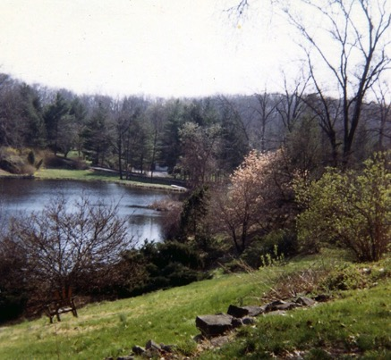
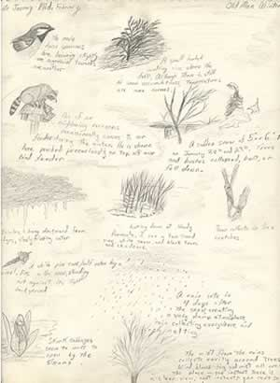
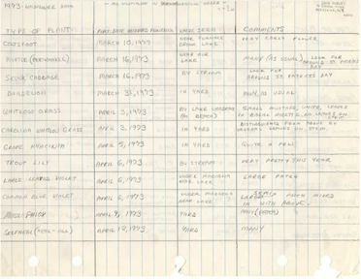

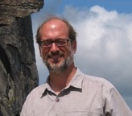
Tree Spotters Citizen Science Program
The importance of observation and recordkeeping
Notes:
Anyone can do this! These are from my brother, Brad Hurley, who documented his observations for 4 years (1971 – 75) when he was 12 – 15 year old. (He’s now a science editor working in the field of climate change.)
Brad Hurley, b 1959. “The journals document my observations over four years, from 1971 to the beginning of 1975. The field notes include data tables, field trip reports, and other devices I dreamed up to record my observations during the same period. The sketchbooks provide another view, more poetic and artistic, of what I was keeping track of in my journals, and "A Naturalist's Notebook" reveals my first attempts at creative nature writing in my early teens. The drawings that illustrate this site are from my sketchbooks, and were done when I was 12-15 years old.”

Slide 18
Tree Spotters Citizen Science Program
Citizen Science
Working definition (Cornell Lab of Ornithology) “Projects in which volunteers partner with scientists to answer real-world questions.”
Can involve one person or millions. Public involvement is typically in data collection, analysis, or reporting.
Allow for investigations at continental and global scales and across decades leading to discoveries that single scientists could never achieve on their own.
Notes:
We talked a little about this when we were talking about the benefits of Tree Spotting
Defining Citizen Science (source; Cornell Lab of Ornithology)
The term "citizen science" has been used to describe a range of ideas, from a philosophy of public engagement in scientific discourse to the work of scientists driven by a social conscience.
In North America, citizen science typically refers to research collaborations between scientists and volunteers, particularly (but not exclusively) to expand opportunities for scientific data collection and to provide access to scientific information for community members. The fields that citizen science advances include ecology, astronomy, medicine, computer science, statistics, psychology, genetics, engineering, meteorology, and many more.
AKA “community Science” "crowdsourced science," “volunteer monitoring,” "public participation in scientific research”
Nature’s Notebook is a Citizen Science project.
How will citizen science affect the future of scientific research?
By Bridging Gaps. Citizen science bridges gaps by harnessing the power of people who are motivated by curiosity, a desire to advance research, or a concern about environmental conditions in their communities, then connecting them to projects that benefit from their energy and dedication.
By Broadening Scope. Thousands of people from around the globe can remotely contribute to a study and provide, analyze, or report data that researchers can use. Public participation enables investigations that would not otherwise be possible, ones that push new frontiers in our understanding of our world.
By Influencing Public Policy. Increased public participation in scientific research will ideally cultivate a citizenship that is knowledgeable about the scientific enterprise. Citizen science encourages people to take a stake in the world around them. As a result, the hope is that this informed public will play an valuable role in influencing larger decisions about science policy. There are national and international groups pushing for this right now.
For those people interested in knowing more: SciStarter provides a database of > 600 active, searchable Citizen Science projects.
My current favorite projects:
- mPING – “Crowdsourcing weather reports”: http://mping.nssl.noaa.gov/
- eBird – “Global tools for birders, critical data for science”: http://ebird.org/content/ebird/

Slide 19
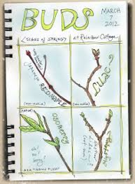
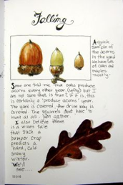

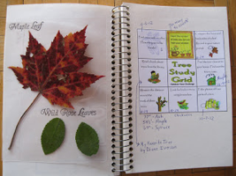
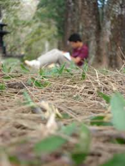
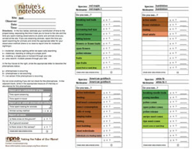
Tree Spotters Citizen Science Program
Journaling tips
Notes:
One last slide before we move on to a little exercise and a short break.
Journaling tips in general:
It is ideal to make and record your observations – whatever you are observing – frequently, so you can see what changes are happening. If you don’t see anything in your observation place during your observation time, it is important to note that as well. You’ll then be able to better understand the first time you do see something.
ASK IF ANYONE KEEPS A JOURNAL ALREADY ???? – any kind of journal. I started keeping a gardening journal last year, when I finally had a little more time to garden, and I’ve really been enjoying it. I’m also using an app called Day One that makes it easy to include photos in an online journal, and I’ve been pretty good at keeping up with it, although I do find it a challenge sometimes.
As Tree Spotters, we expect you to follow the Nature’s Notebook procedures for tracking our 11 species of trees. (We will be talking about that later.) However, you can observe anything you are interested in and keep any kind of journal that you like while you are at it!

Slide 20
Tree Spotters Citizen Science Program
Exercise: Meet a fellow Tree Spotter!
Overview
Pair up with someone you don’t know. Each person should be prepared to listen and to take notes. You will be interviewing each other in Part A and introducing the person you interviewed to the entire group in Part B.
Part A
You have 90 seconds each to interview each other, using the questions on the next slide as your guide. At the end of 90 seconds, I will say SWITCH – and if you haven’t switched already, you know what to do ☺
At the end of three minutes total I’ll say STOP. That’s the end of Part A.
Part B
We will go around the room and each person will introduce the person he or she interviewed to the whole group.
Notes:
Write the interview questions on the white board ahead of time, but turn it around so they can’t see it until we are ready to do the exercise.
If there is an odd number, ask Danny to pair up with the lone person.
We have 30 minutes total for this, so these introductions should be brief. There will be a 5 minute break after this before I turn things over to Jehane.
Interview Questions
What is your name?
Where do you live?
How long have you lived there?
What is your favorite outdoor place and why?
What aspect of Tree Spotting appeals to you most? For example: Being outdoors? Being a Citizen Scientist? Getting to know the Arboretum’s trees? Learning about tree lifecycles?
We need to say something about ourselves too!

Slide 21
Tree Spotters Citizen Science Program
Exercise: Meet a fellow Tree Spotter!
Interview Questions
What is your name?
Where do you live?
How long have you lived there?
What is your favorite outdoor place and why?
What aspect of Tree Spotting appeals to you most?
Notes:
Write the interview questions on the white board ahead of time, but turn it around so they can’t see it until we are ready to do the exercise.
If there is an odd number, ask Danny to pair up with the lone person. (Danny will take notes and summarize what people say and add to Teamwork.)
We have 30 minutes total for this, so these introductions should be brief. There will be a 5 minute break after this before I turn things over to Jehane.
Interview Questions
What is your name?
Where do you live?
How long have you lived there?
What is your favorite outdoor place and why?
What aspect of Tree Spotting appeals to you most?
For example: Being outdoors? Being a Citizen Scientist? Getting to know the Arboretum’s trees? Learning about tree lifecycles?
We need to say something about ourselves too!

Slide 22
Tree Spotters Citizen Science Program
5 minutes
Notes:
We’ll take a quick break and get started again at ___________

Slide 23

Tree Spotters Citizen Science Program
Hands-on Tree Spotting
Notes:
Try to get a good photo this weekend!

Slide 24
Tree Spotters Citizen Science Program
The ABCs of Tree Spotting
Navigating our digital resources
Overview of Nature’s Notebook
Understanding phenophase definitions
Observing and recording your observations
Entering your observations into Nature’s Notebook
Getting data out of Nature’s Notebook

Slide 25
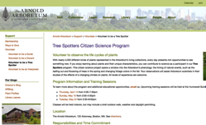
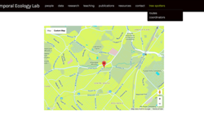
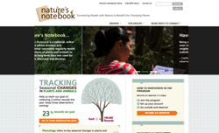
Tree Spotters Citizen Science Program
Navigating our digital resources
Arboretum Website
Tree Spotters Page
-Sign up for the program and register for events
-Program description and general info
Temporal Ecology Website
Tree Spotters Page
(Our "Headquarters")
-Access training resources, handouts, maps, and data sheets
-View event calendar
-Social media links: Facebook, Twitter, Flickr
Nature’s Notebook/
NPN Website
-Create Nature’s Notebook account
-Access Observation Deck and record observations
-Access and visualize recorded data

Slide 26
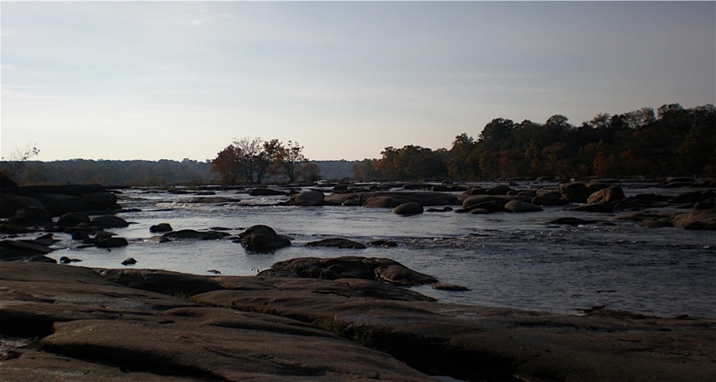


Tree Spotters Citizen Science Program
Overview of Nature’s Notebook
Photo credit: L. Barnett

Slide 27
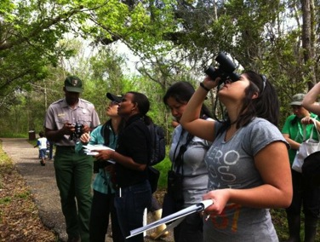
Tree Spotters Citizen Science Program
Primary goal
Create a standardized, long-term dataset for use in multiple types of research.
Mission
Make phenology data, models and related information available.
Encourage people of all ages and backgrounds to observe and record phenology.
Understand how species and landscapes are responding to climate change.
Photo credit: C. Enquist
Notes:
What we are….

Slide 28
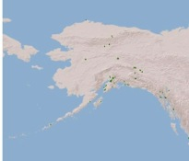
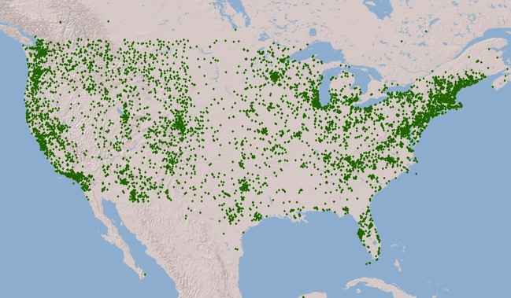
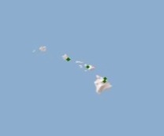
Tree Spotters Citizen Science Program
Plant and animal species = 1016 total
5,412 observers reporting (15,788 total) making 791, 090 observations
15,364 sites, 7,289 active sites
As of June 16, 2015
Notes:
See below! This slide should be updated before each training class. The above numbers are for June 16, 2015 but the map is the original.
This slide is a generic slide used to discuss the coverage of plants and animals and spatial distribution of the sites. The number of observers and observations changes daily, so we suggest updating that figure before your presentation using the following dashboard: https://www.usanpn.org/node/21094. The numbers on this particular slide were pulled on 8/12/14 at 2:33 pm Pacific Time. The number of observers reporting (3707) indicates the number of active observers in the database. The 11,336 observers total indicates the number of people who registered and who are active. You can see that about 1/3 of our observers register and have submitted at least one observation. The rest have not gotten to that point yet, and we are hoping to increase that number by doing trainings. The total number of observations, 593,177 is the total number of observations (one for each phenophase protocol in the database). And the number of sites is self explanatory between the registered vs. active.

Slide 29
Tree Spotters Citizen Science Program
Understanding phenophase definitions
Plants
Leaves
Flowers
Fruits
Phenophases: Observable life cycle events
Notes:
For all plants and animals, each of the life cycle events we can observe are called phenophases. At the most basic level they are as indicated on this slide. What is the animal doing? And How? And for plants, the Leaves, Flowers, and Fruits of the life cycle.

Slide 30
Tree Spotters Citizen Science Program
Deciduous Plant Phenophases
Breaking leaf buds
Leaves
Increasing leaf size
Colored leaves
Flowers or Flower Buds
Open Flowers
Fruits
Ripe Fruits
Recent fruit or seed drop
Notes:
This slide demonstrates the annual cycle of phenophases for a deciduous tree. The boxes indicate each of the categories of phenophases and how they may overlap during the growing season. Of course, variation is possible, but this provides a general sense of how phenophases may appear when recorded in the database. NOTE that the main phenophases, such as leaves and fruits will be YES if there are, at all, leaves or fruits on the tree.

Slide 31
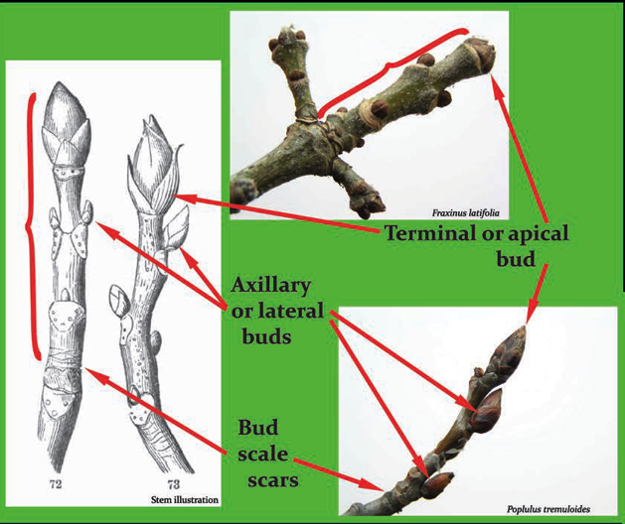
Tree Spotters Citizen Science Program
About buds, in general
Notes:
Buds are embryonic and undeveloped shoots from which leaves, stems, and flowers arise.
Buds in woody plants from colder climates often have tough, protective outer scales.
Dense energy, preformed tissue that can expand for spring – dormant over the winter
Food source for deer/herbivores
Buds are dried out over the winter to avoid freezing, so less browsed upon – fuzz on them to protect against insects
Winter moth worms inside buds over winter that will open up in spring when buds expand
Distinguishing between leaf and flower buds – depends on the species, can use online resources for guidance, or use photographs taken of our specific trees – can use flickr site to help, google blogs and websites

Slide 32
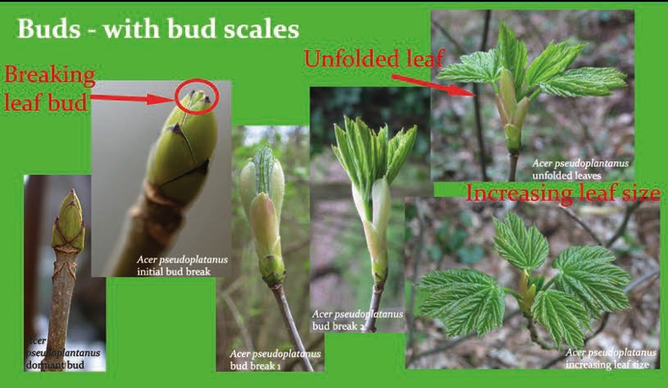
Tree Spotters Citizen Science Program
About buds, in general
Notes:
Here you can see the process of a scaled bud breaking, then leaves unfolding and increasing in size.
Buds are protected by scales – when is that moment in time when the leaves become a breaking leaf bud, if scales begin to separate, or between scales green leaves can be seen coming out of those. Some trees have different color leaves for breaking leaf bud
As leaves are emerging from the bud – once leaf stem and leaf is unfolded then leaves are seen, past breaking leaf bud
Increasing leaf size until the majority of the leaves are fully formed

Slide 33
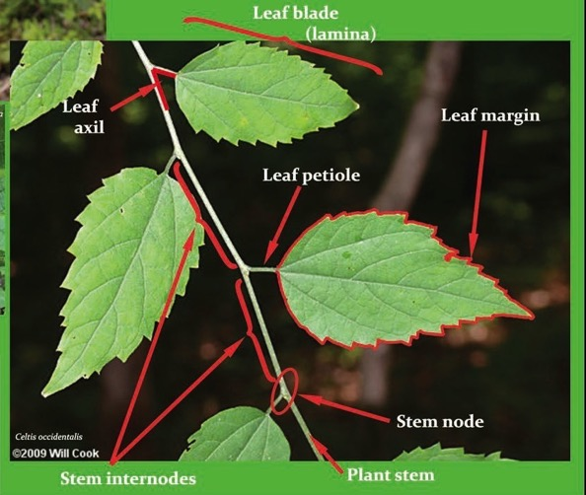
Tree Spotters Citizen Science Program
About leaves, in general
Notes:
A leaf consists of a leaf blade.
Many leaves have a petiole – a stem that attaches the leaf blade to the stem or branch of the plant. This is a critical structure for determining the answer to the question of breaking leaf buds.

Slide 34
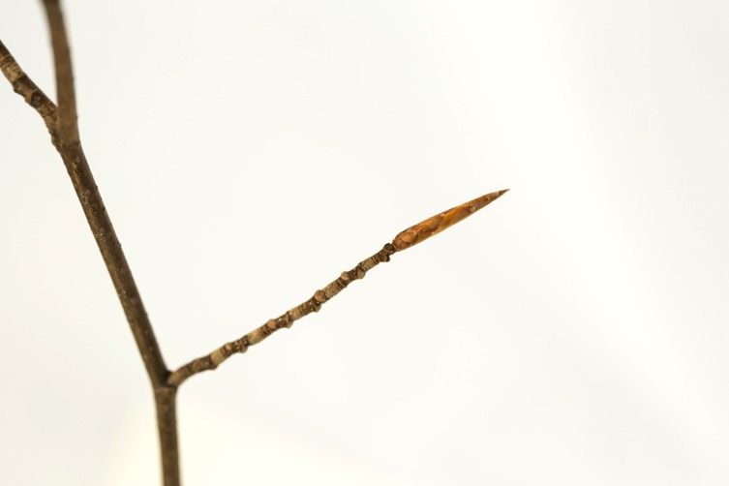
Tree Spotters Citizen Science Program
About Beech leaves
Notes:
A dormant beech bud. Fagus grandifolia. Photo Credit: Tim Savas, Wolkovich Lab.
What causes bud break?
Leaf out is prompted by unknown factors – possibly photoperiod, temperature, precipitation, really depends on the type of tree

Slide 35
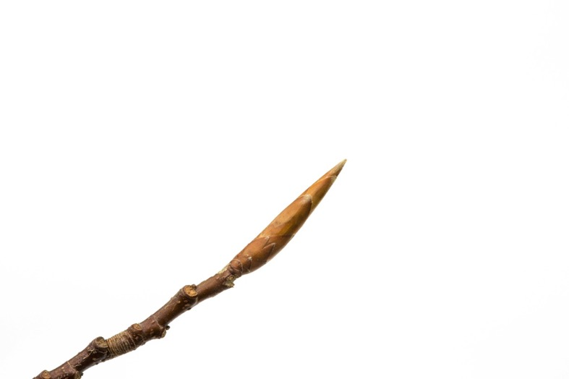
Tree Spotters Citizen Science Program
About Beech leaves
Notes:
A swelling Beech Bud. Photo Credit: Tim Savas, Wolkovich Lab.

Slide 36
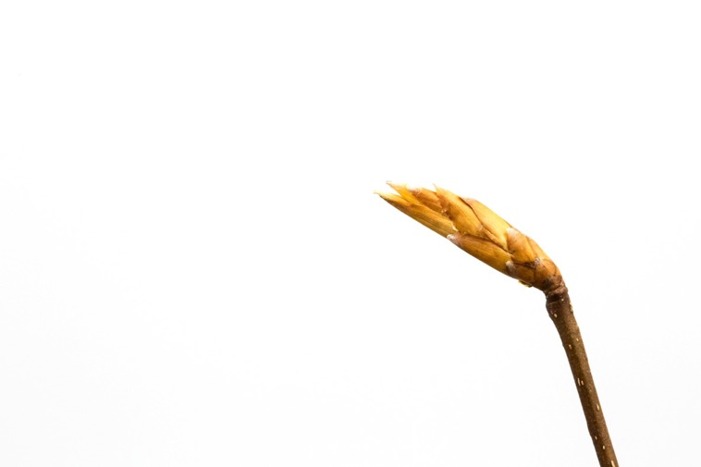
Tree Spotters Citizen Science Program
About Beech leaves
Notes:
A beech bud at the beginning of bud break. Fagus grandifolia. Photo Credit: Tim Savas, Wolkovich Lab.
Scales are really seperating from each other

Slide 37
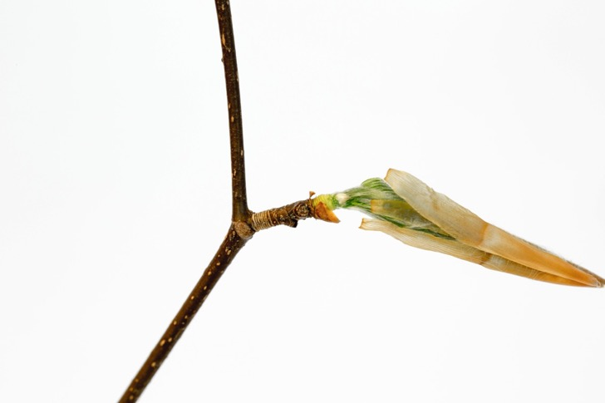
Tree Spotters Citizen Science Program
About Beech leaves
Notes:
A beech bud at the end of bud break. Note the brand-new, yellow colored bud scale scars, in juxtaposition with the brown bud scale scars of the previous year.
Fagus grandifolia. Photo Credit: Tim Savas, Wolkovich Lab.

Slide 38
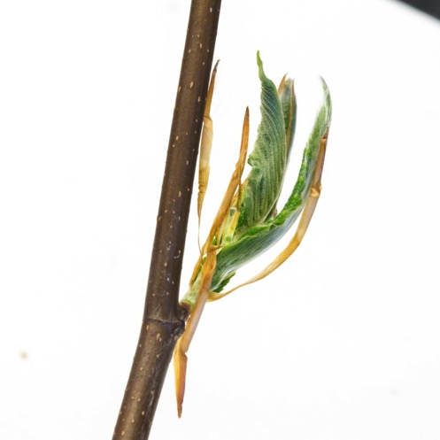
Tree Spotters Citizen Science Program
About Beech leaves
Notes:
Breaking Leaves. Fagus grandifolia. Photo Credit: Tim Savas, Wolkovich Lab.

Slide 39
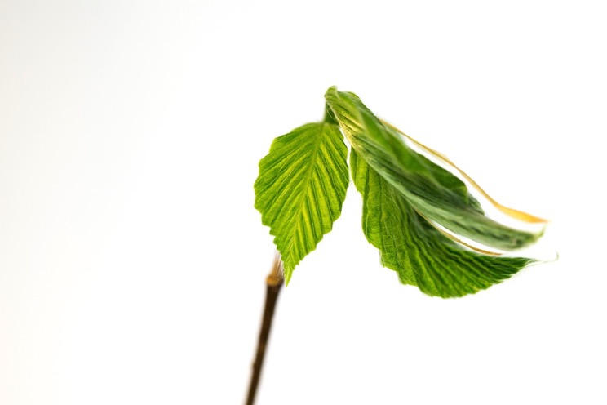
Tree Spotters Citizen Science Program
About Beech leaves
Notes:
Transition between breaking leaves and leaf expansion. Fagus grandifolia. Photo Credit: Tim Savas, Wolkovich Lab.

Slide 40
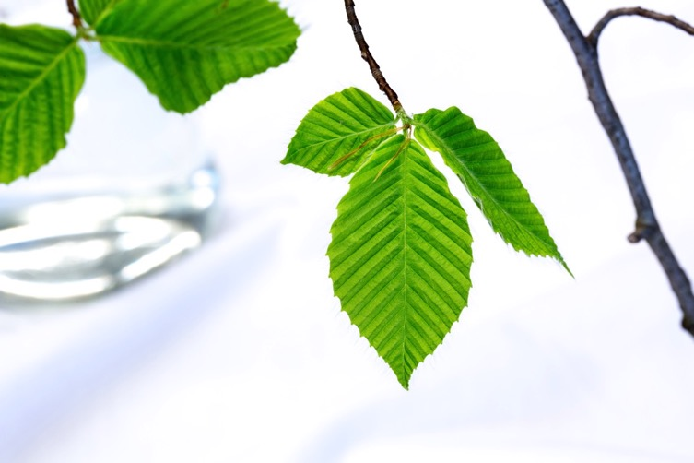
Tree Spotters Citizen Science Program
About Beech leaves
Notes:
Leaf expansion. Petioles visible (at base of leaves). Fagus grandifolia. Photo Credit: Tim Savas, Wolkovich Lab.

Slide 41
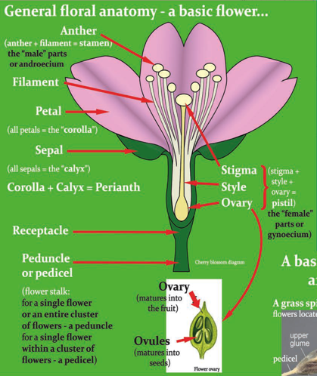
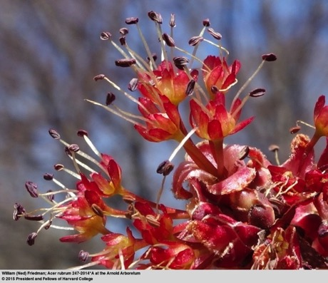
Tree Spotters Citizen Science Program
About flowers, in general
Notes:
There is a lot of variation in flowers, but here is one example of a flower.
A flower is supported by a peduncle or pedicel, or flower stalk, attached at a stem node.
Most flowers have 4 arrangements of flower parts – sepals, petals, stamens, pistil.
Sepals usually serve to protect the flower bud, before the flower opens.
Petals are the showy parts of the flower, help advertise to pollinators that they are ready for visitation and pollination.
Stamens are a collection of the anther and filament, the male parts of a flower.
Pistils are a collection of the stigma, style, and ovary, which, if pollinated, turns into the fruit.
In some plants the male and female flower parts will be on separate flowers (monoecious), or even separate plants (dioecious).
Petals attract pollinators
Anther is male part with pollen at tip
Stigma is the female part that brings pollen down to the ovary
Bunny ears in between petals and then the helicopter pieces become fertilized and drop
Male and female flowers look very different

Slide 42
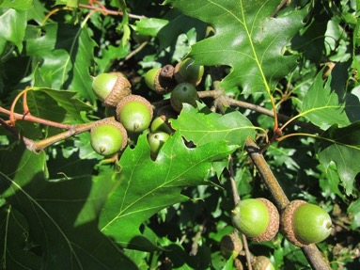
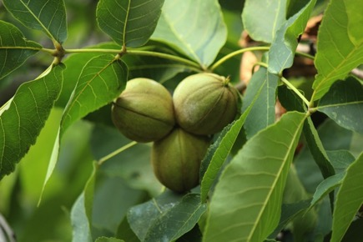
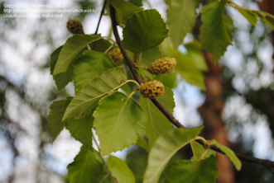



Tree Spotters Citizen Science Program
About fruit, in general
Shagbark hickory
River birch
Red oak
Linden
River birch
Sugar maple
Sugar maple
American beech
American beech
Notes:
Diversity of fruit across the different trees
Catkins in the birch trees are composed of hundreds of flowers
Understand what fruit you are looking for before you start
Seed vs. nut? Nut is a seed that has an embryo inside of it with flesh around it, nutrition inside of the nut feeds the embryo
capsule

Slide 43


Tree Spotters Citizen Science Program
Phenophases: What to look for when
Notes:
This slide demonstrates the annual cycle of phenophases for a deciduous tree. The boxes indicate each of the categories of phenophases and how they may overlap during the growing season. Of course, variation is possible, but this provides a general sense of how phenophases may appear when recorded in the database. NOTE that the main phenophases, such as leaves and fruits will be YES if there are, at all, leaves or fruits on the tree.
Don’t take it out with you as guidance, simply use it as a way to suggest when you should be going out
Flower before leaf out – oftentimes wind pollinated, as is the case with the birches
Phenocam uses color codes for larger imagery for phenology across the country

Slide 44
Tree Spotters Citizen Science Program
Phenophases recap
Plant
Leaves
Flowers
Fruits
Young leaves
Leaves
Colored leaves
Flowers or flower buds
Open flowers
Ripe fruits
Recent seed or fruit drop
Notes:
This is an expansion of the earlier slide, depicting the full suite of protocols we ask for many of the species in our database. It should be noted, though, that until people are very familiar with what their individual of the species looks like, they should feel comfortable with just entering the data at the basic level – e.g. leaves flowers, fruits, or presence or absence of an animal. Lastly, the abundance of each species can be captured. Any observation is valuable, so it is not a problem for participants to start with the easiest thing for them to observer and then increase the data they capture through time.

Slide 45
Tree Spotters Citizen Science Program
Q&A: Phenophase definitions
Have you observed any of these phenophases yourself? Does any of this sound familiar to you?
Is there anything you find confusing?
Is there something you’d like to understand better?
Notes:
How much time should we allow for this?
We could speed this up by having us ask them questions - and pick on people if we have to. It would not be a table discussion.
I suggest we use the white board to keep track of the the things that people find confusing and would like to understand better and then follow up after class.

Slide 46
Tree Spotters Citizen Science Program
Observing and recording your observations
Notes:
How much time should we allow for this?
We could speed this up by having us ask them questions - and pick on people if we have to. It would not be a table discussion.
I suggest we use a flip chart to keep track of the the things that people find confusing and would like to understand better and then follow up after class.

Slide 47



Tree Spotters Citizen Science Program
Do you see… breaking leaf buds?
Breaking leaf buds (BLB) = One or more breaking leaf buds are visible on the plant.
A leaf bud is considered "breaking" once a green leaf tip is visible at the end of the bud, but before the first leaf from the bud has unfolded to expose the leaf stalk (petiole) or leaf base.
Photos: Oak, Ellen Denny
Leaf stalk or petiole is visible.
Notes:
Once you see one leaf from that bud unfolded it’s no longer a breaking leaf bud. But, there could still be other leaf buds breaking on the plant, as not all buds on a plant break at the same rate.
BLB for the plant is over when all the leaf buds have at least one leaf with petiole visible.

Slide 48

Tree Spotters Citizen Science Program
Do you see…open flowers?
Open flowers = Open, fresh flowers are visible on the plant.
Flowers are considered "open" when the reproductive parts (male stamens or female pistils) are visible between or within unfolded or open flower parts (petals, floral tubes or sepals). Do not include wilted or dried flowers.
For Tilia americana, ignore the light green bracts and watch for the opening of the small yellow flowers stemming from each bract.
http://www4.uwsp.edu/biology/courses/plantid/098-Tilia_americana.htm
Notes:
We have phenophase definitions for each of the protocols for all of the species in our database. This is a sample description for open flowers for a deciduous tree, in this case, Tilia amercana, American Basswood, aka Linden.
The definitions were written to be interpreted very literally, so we advise not reading anything into the definition when recording your observations.

Slide 49


Tree Spotters Citizen Science Program
Do you see… flowers or flower buds?
Photos: Oak, Ellen G Denny
Notes:
Black oak, male flowers, don’t count if wilted, pollen gone might stay on a long time,
IN the case of persistent dead flowers on some oaks, again, don’t count them as flowers or flower buds – if they are dead/wilted, only if actively growing.
Yes Flowers/flower buds and yes open flowers with active pollen – two different categories would be checked

Slide 50










Tree Spotters Citizen Science Program
Do you see… fruit? ripe fruit?
River birch (Betula nigra)
Pollination
Dehiscence
Unripe fruit
Ripe Fruit
Female flower
Unripe fruit
Seeds
Maturation & Ripening
Shagbark hickory (Carya ovata)
Pollination
Dehiscence
Female flower
Seeds
Unripe fruit
Ripe Fruit
Maturation & Ripening
Notes:
Fruit develops after the ovary of a pollinated female flower begins swelling. Male flower droops a bit but still a catkin
In the case of river birch, fruit is present when the tiny nutlets begin developing in the catkin. It is considered ripe once the catkin and nutlets turn brown and harden..
In the case of shagbark hickory, the fruit is a nut enclosed in a thick husk. It is considered ripe once the husk turns brown, hardens and splits open to expose the nut.

Slide 51



Tree Spotters Citizen Science Program
TIP: How to spot flowers and fruit in tall trees
White oak (Quercus alba)

Slide 52



Tree Spotters Citizen Science Program
Leaves
Flowers
Fruits
Sugar maple (Acer saccharum)
Notes:
Need a better photo!!!!!!!!!
This is an example of the full suite of protocols on one of our data sheets – in this instance, a gambel oak. The protocols for any of the oaks will be the same, as they are in the deciduous tree functional group. The more basic protocols are circled, so observers can see how they can start there. You may choose to use a species found near you, OR one that you are asking your participants to observe. I simply captured the protocols from a datasheet and saved the cap as an image – pasted it in here.

Slide 53
Tree Spotters Citizen Science Program
YES
NO
?
Notes:
We ask participants to capture either YES they see the phenophase, NO they do not see the phenophase, or ? If they are UNSURE if they phenophase is occurring. It is absolutely OK for participants to indicate that they are unsure. From a data quality perspective we would rather know that someone was observing and unsure instead of guessing the answer (which could be incorrect).
If you did not look for the phenophase, DO NOT CIRCLE ANYTHING.
Once you click "submit observations" your observations will show in blue, but may be edited.

Slide 54


Tree Spotters Citizen Science Program
Entering observations into Nature’s Notebook
Choose Arnold Arboretum - Tree Spotters Program as your site
https://www.usanpn.org/natures_notebook
Notes:
How much time should we allow for this?
We could speed this up by having us ask them questions - and pick on people if we have to. It would not be a table discussion.
I suggest we use a flip chart to keep track of the the things that people find confusing and would like to understand better and then follow up after class.

Slide 55

Tree Spotters Citizen Science Program
Observation Deck -> Site -> Route -> Tree
Notes:
When you select the Arnold Arboretum - Tree Spotters Program, you will see all our routes. When you select a route, you will see all the trees on that route.
Note that you can’t add to or edit the Tree Spotters information. You are seeing what I see as a program administrator, so there are some things here that will not appear on your screen.

Slide 56


Tree Spotters Citizen Science Program
Observation Deck -> Enter Observations
We encourage you to fill in your time, but it’s optional.
Notes:
The most important part of taking the observations is remembering to go back and enter them in the online database for you (and for others) to access. The online interface looks identical to the datasheets, with the same protocols.
Filling in your time will help us to promote the program. We have number of observations but knowing how much time people are putting in gives additional weight.

Slide 57
Tree Spotters Citizen Science Program
Clarifying what data NPN wants reported
No category for "dormant buds”, but you can mention these in your notes for each tree.
"Flowers or Flower Buds" refers to flower buds that are clearly swelling or that are open and still fresh.
Continue marking "breaking leaf buds" whenever you see them throughout the season. Sometimes trees will get a second "flush" of leaves, even when the canopy is already green, and this is interesting to know about.

Slide 58

Tree Spotters Citizen Science Program
Editing data previously entered into Nature’s Notebook
https://mynpn.usanpn.org/npnapps/faces/private/users/entryForm.xhtml

Slide 59


Tree Spotters Citizen Science Program
Estimating values and intensities
For our purposes, we do NOT need intensity data.
Intensity data is very subjective and therefore less reliable.
If you feel excited about entering this data, though, go for it!

Slide 60

Tree Spotters Citizen Science Program
Free mobile app: Use with Caution
Works with Android and Apple products.
Help sheets to get started: https://www.usanpn.org/node/22250
When in doubt, use a paper data sheet.
You MUST have your account completely set up online first to use the mobile apps!
Notes:
The FREE mobile apps have made life a lot easier for people in the field. Our apps for iPhone and Android are downloadable from the iTunes store (and work on phones and iPads) and the Google Play store. Search for “natures notebook” without an apostrophe S in either location. We recommend setting up accounts online FIRST before downloading the app bc it can be difficult to create a user name and a site on a small screen. However, once your information is online and you download the app, you can log in on the phone or tablet and all of your information, including sites and species, becomes pre populated. The apps both work when participants are out of cell phone range, the data is stored locally and uploaded when they return to service.

Slide 61
Tree Spotters Citizen Science Program
Getting data out of Nature’s Notebook
Two tools:
Data Visualizer (view online)
Data Download (view offline)
Access these tools via:
https://www.usanpn.org/data/dashboard
Notes:
The FREE mobile apps have made life a lot easier for people in the field. Our apps for iPhone and Android are downloadable from the iTunes store (and work on phones and iPads) and the Google Play store. Search for “natures notebook” without an apostrophe S in either location. We recommend setting up accounts online FIRST before downloading the app bc it can be difficult to create a user name and a site on a small screen. However, once your information is online and you download the app, you can log in on the phone or tablet and all of your information, including sites and species, becomes pre populated. The apps both work when participants are out of cell phone range, the data is stored locally and uploaded when they return to service.

Slide 62





Tree Spotters Citizen Science Program
Visualizer
Red maple (Acer rubrum) in 2013
collected via Nature’s Notebook
http://www.usanpn.org/data/visualizations
Notes:
You can register on the NPR Website: https://www.usanpn.org/nn/webinars. Click on “MORE WAYS TO CONNECT”, on the far right of the Nature’s Notebook Home page header and choose “Attend a Webinar” from the pull-down list.
There are two ways to get data out of the database – via our visualization tool and our data download tool. This slide shows the output of data for the red maple in 2013 – a comparison between the north eastern US and south eastern US. The colors correspond to when phenophases were occurring – where there is a color hash mark, someone entered YES for that phenophase occurrence. The months of the year are found along the X axis on the bottom of each section. You can see at a quick glance that the phenophases occurred, as expected, earlier in the southern US. It is worth pointing out that the lighter gray hashes indicate where someone had answered NO to the phenophase occurrence. And the dark gray background indicate that there is no data for that phenophase.
This screen cap also does a good job demonstrating the aggregation of sites to obtain a larger amount of observations. As such, you can see that the observations were recorded throughout the entire year, thus providing a snapshot of the full suite of phenophases for red maple.
This page is accessible from the link included – there are also tutorial videos on how to use it on that webpage

Slide 63
Tree Spotters Citizen Science Program
Data Download
https://www.usanpn.org/results/data
Notes:
The other option for downloading the data is our data download tool. End users can download any combination of data and export it to an excel file for use in data analysis. On the page listed there are tutorials about how to use the tool.

Slide 64



Tree Spotters Citizen Science Program
Lilac Dataset
Tim's Video
Day of Year
T. Ault, M. Schwartz, R. Zurita-Milla
www.usanpn.org/nn/cloned-plants
Notes:
This slide is a graphic representation of our lilac dataset, first flower date animated to show the onset of spring through the last 70 years. I often point out that this was one of the first phenology citizen science projects, launched and hosted by Joe Caprio at Montana State University. He collected observations from people across the US, including data obtained from USDA and experimental ranges and hand transcribed the data each year. Now, that long standing dataset is quite valuable in our understanding of the onset of the spring season from year to year. Here is some more information on this historical project: https://www.usanpn.org/node/36

Slide 65

Tree Spotters Citizen Science Program
Review
Long term monitoring of the same individual plants is key
“No” observations are important
Catch the first and last “Yes”
If uncertain, use “?”
It’s OK not to circle anything
No need to include values
Include additional observation in the Comments field
Report your time (optional)
Notes:
If you didn’t make an attempt to observe something, don’t circle anything.

Slide 66
Tree Spotters Citizen Science Program
Wrap Up
Quick recap
What happens next
Staying in touch
Upcoming events
Each one reach one campaign
Q & A
Paperwork
Thanks!
Notes:
Quick review

Slide 67
Tree Spotters Citizen Science Program
Quick recap
Learned about the Tree Spotters program
Learned how to identify a tree’s life-cycle stages
Learned about Nature’s Notebook
Notes:
We will be sending you the presentation, so you will be able to review the information at your leisure.

Slide 68

Tree Spotters Citizen Science Program
What happens next
Choose your route(s)
Find your trees
Get your stuff together
Observe and record data in the field
Enter your data into Nature’s Notebook
Ask us if you want company or if you need help
Photo: S. Mrozak
Notes:
Choose a route: what species or area am I most interest in? How much of a challenge am I looking for? Do I want company?
Find your trees: Maps on Tree Spotters blog, Arb Explorer, Tree Signs, Accession Tags. You can follow as many trees or as few trees as you wish.
Get your stuff together: Maps, data sheets, reference materials, writing implements, clipboard, sturdy shoes, hat, bug spray, sunscreen, water, binoculars, camera, a friend or two, etc.
Observe and record data in the field: The finer points of observing. Be prepared to look carefully at the whole tree.
Ask us if you want company – or if you need help Suz is actively Tree Spotting and my schedule is pretty flexible, so if you want to go out with me sometime, let me know.
We will be scheduling group sessions soon (next slide)
The Arnold Arboretum is a big place– with over 15 thousand plants, or “accessions” in the collection, it is hard to know where to begin!
We have designed 6 walking routes in the Arboretum with pre-selected trees for Tree Spotter volunteers to observe. These trees were selected based on their relevance to pre-existing research at the Arboretum–many of the Tree Spotter trees are currently part of
Ailene Ettinger’s study on the climate sensitivity of tree species. Since many trees in the Arboretum collection are from entirely different climates, Ailene is collecting information on these trees to understand how tree species may respond to different climates in the future.
Our 7 routes–Beech Route, Birch Route, Hickory Route, Linden and North Woods Route, Maple Route, Oak Route, and Peters Hill Route–vary in terrain and number of trees to observe. Please browse the maps and descriptions to find the right route (or routes!) for your Tree Spotting adventures this season.
Beech Route 5 trees. Closest Arboretum gate: South Street Gate. Moderate terrain, close to paved road. Estimated observation time: 30 minutes.
Birch Route 10 trees. Closest Arboretum gate: Centre Street Gate. Moderate terrain, mostly off-road. Estimated observation time: 55 minutes.
Hickory Route 10 trees. Closest Arboretum gate: Centre Street Gate. Moderate terrain, mostly off-road. Estimated observation time: 55 minutes.
Linden and North Woods Route 7 trees. Closest Arboretum gate: Arborway Gate. Mild terrain, mostly off-road. Estimated observation time: 40 minutes.
Maple Route
4 trees. Closest Arboretum gate: Arborway Gate. Mild terrain, mostly off-road. Estimated observation time: 35 minutes.
Oak Route 9 trees. Closest Arboretum gate: Centre Street or South Street Gate. Moderate to challenging terrain, mostly off-road, some wood-chip path. Estimated observation time: 60 minutes.
Peters Hill Route 10 trees. Closest Arboretum gate: Peters Hill Gate, Poplar Gate, or Mendum Street Gate. Mild terrain, mostly on-road, but longest walking distance. Estimated observation time: 50 minutes (not including walking time).

Slide 69
Tree Spotters Citizen Science Program
Staying in touch
Temporal Ecology Lab website
Facebook
Flickr
Twitter
Spotting Together
Focus Tree Gatherings
Notes:
Temporal Ecology Lab website contains: (LIST)
Spot On! eNewsletter – goes out about once a month to all Tree Spotters. Tell them where they can find it online.
Facebook
Flickr
Twitter
Summer potluck – something we are hoping to do this summer if we can.

Slide 70
Tree Spotters Citizen Science Program
Temporal Ecology Lab website
Training slides
Additional training materials
Tree Spotter Events Calendar
Spot On! eNewsletter archive
Focus Tree notes
Tree Spotter Fact Sheets
Tree Spotter Route Maps
Tree Spotter Datasheets
Links to NPN resources
Notes:
What else? Make sure this is all available…
Talk about Spot On!

Slide 71
Tree Spotters Citizen Science Program
Facebook, Flickr, and Twitter
Facebook
Info about Tree Spotter activities and items of general interest to Tree Spotters
Everyone is welcome to post items that benefit the Tree Spotter Community
Flickr
Limited to photos of Tree Spotter trees and events
Must tag with accession # and date
Twitter
Items of interest to Tree Spotters
Notes:
See The Tree Spotters Get Social handout for details

Slide 72


Tree Spotters Citizen Science Program
Spotting Together
Walks led by one or more of the Tree Spotters Team members. (Approximately 1 hr.)
Visit specific trees that are of particular interest at the time.
Record observations.
March through November.
Focus Tree Gatherings
Photo: S. Mrozak
Meet monthly at one of our trees. (Approximately 30 - 45 minutes.)
Tree Spotter team members talk about the tree’s life cycle and share some fun facts.
Record observations.
March through November.
Photo: D. Schissler
Notes:
Spotting Together: We obviously can’t schedule these activities too far in advance, but you will be notified whenever a session is scheduled.
No registration required for either of these activities but we do have a sign-up sheet for the first Spotting Together class, which will be March 19th from 1:00 – 2:15 PM at Peters Hill (rain date March 20th).
We are always happy to stick around afterwards and answer any questions you may have.

Slide 73

Tree Spotters Citizen Science Program
Upcoming events
Spotting Together
Thursday June 2nd, 6:30 – 7:15 PM
Meet at the Hunnewell Building.
Bring your Linden/North Woods Route and Birch Route Observation Datasheets, a clipboard, a writing implement, and binoculars and/or a hands lens if you have them.
NOTE: We will reschedule in case of rain. You can email us at TreeSpotters@fas.harvard.edu a day in advance if you are in doubt or you can text Suzanne at 857-321-2825.

Slide 74
Tree Spotters Citizen Science Program
Upcoming events
Focus Tree Gatherings
June Focus Tree: Tilia americana (American linden, aka Basswood), Wednesday, June 15th, 6:30 PM
Meet at tree #1 on the Linden/North Woods Route (Accession #17527*D)
Bring binoculars and/or a hand magnifier if you have them!
NOTE: We will reschedule in case of rain. You can email us at TreeSpotters@fas.harvard.edu a day in advance if you are in doubt or you can text Suzanne at 857-321-2825.
Notes:
We will let you know if we need to reschedule for any reason.

Slide 75
Tree Spotters Citizen Science Program
Upcoming events
Focus Tree Gatherings to be scheduled
July: Betula alleghaniensis (Yellow birch)
August: Carya glabra (Pignut hickory)
September: Fagus grandifolia (American beech)
October: Acer saccharum (Sugar maple)
November: Quercus rubra (Northern red oak)
Notes:
Here are my suggestions through November:
July: Betula alleghaniensis
August: Carya glabra
September: Fagus grandifolia
October: Acer saccharum
November: Quercus rubra

Slide 76

Tree Spotters Citizen Science Program
Each One Reach One Campaign
Tree Spotting is fun to do with friends!
We’ll have one more class this season in early September. Details will be posted on the Volunteer to be a Tree Spotters page on the Arb website.
Notes:
We would like to get as many people as possible involved. There is no limit. The more people we have, the more data we can collect! So encourage people you know to try it,

Slide 77

Tree Spotters Citizen Science Program
Q & A
Notes:
Have we covered everything?
If not, we need to make sure we have a plan for following up and getting answers to people
We should have a list of action items for ourselves.

Slide 78
Tree Spotters Citizen Science Program
Paperwork
Please fill out the “Tree Spotters Training Evaluation Form” and return it to Danny before you leave.
How to contact us
TreeSpotters@fas.harvard.edu
And we will be contacting you!
Notes:
We will be sending you a link to today’s presentation, which will be posted on the Temporal Ecology website.

Slide 79

Tree Spotters Citizen Science Program
Notes:
Thanks for your interest and for coming today. We look forward to working with you as we build the Tree Spotters Program ☺

